Slide 1
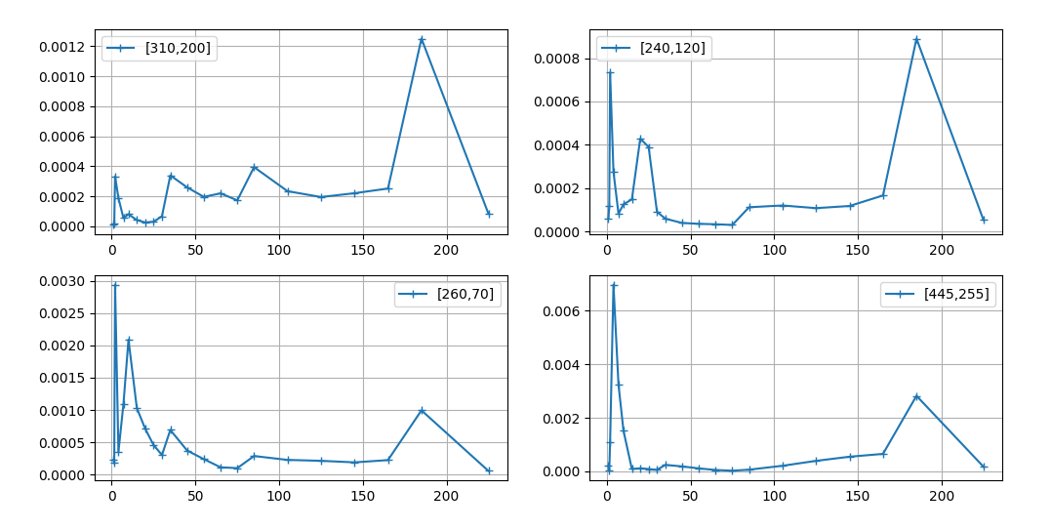
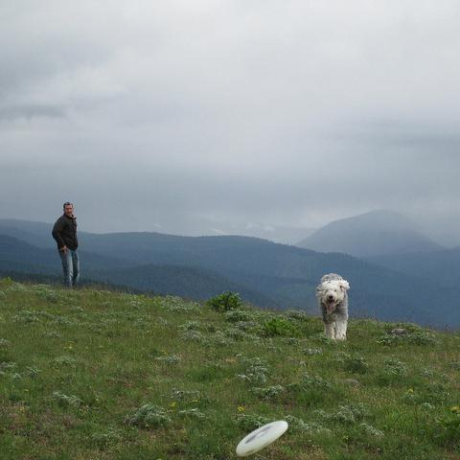
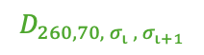


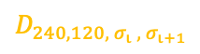
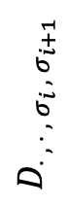

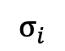
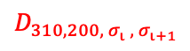
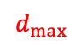
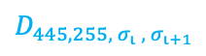
$$d_{max}$$
$$D_{240, 120,{ σ}_{ι} ,{ σ}_{ι+1}}$$
$$d_{max}$$
$$D_{310, 200,{ σ}_{ι} ,{ σ}_{ι+1}}$$
$$D_{⋅ , ⋅ ,{ σ}_{i} ,{ σ}_{i+1}}$$
$$d_{max}$$
$$d_{max}$$
$$D_{445, 255,{ σ}_{ι} ,{ σ}_{ι+1}}$$
$$D_{260, 70,{ σ}_{ι} ,{ σ}_{ι+1}}$$
$$σ_{i}$$
Notes:
tg

Slide 2
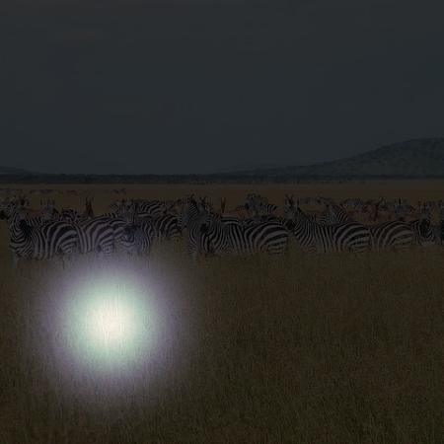
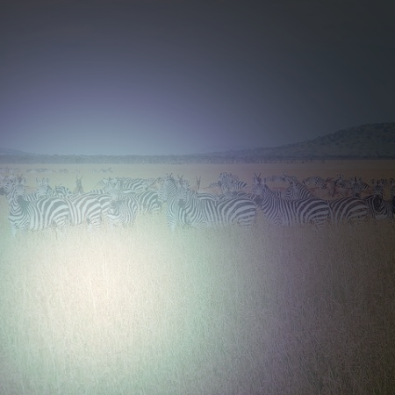
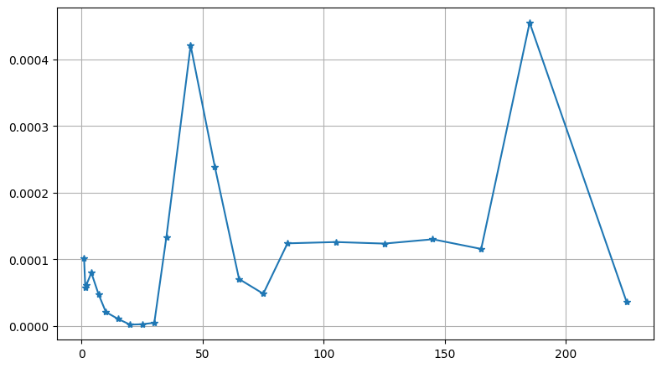
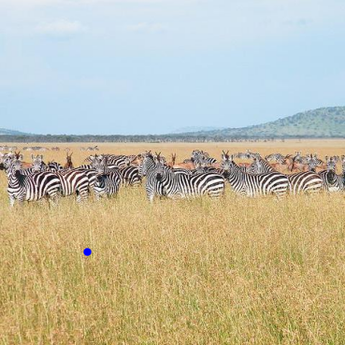
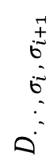
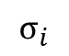
$$D_{⋅ , ⋅ ,{ σ}_{i} ,{ σ}_{i+1}}$$
$$σ_{i}$$

Slide 3
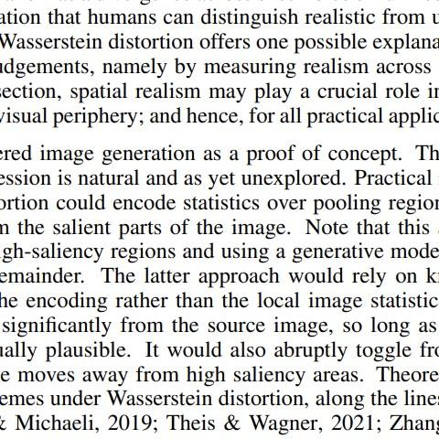
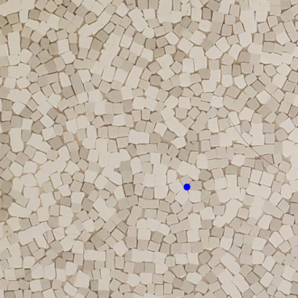
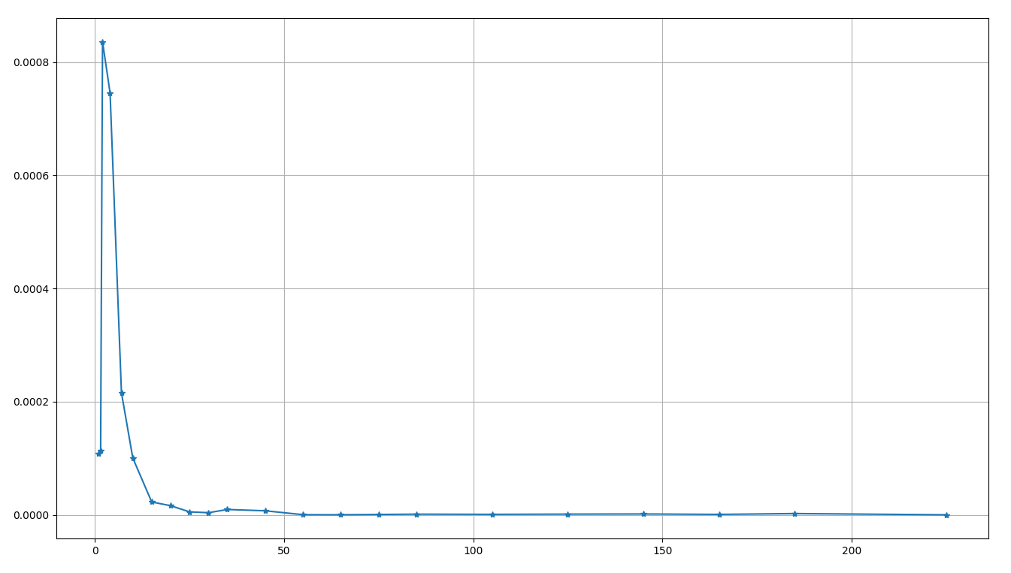
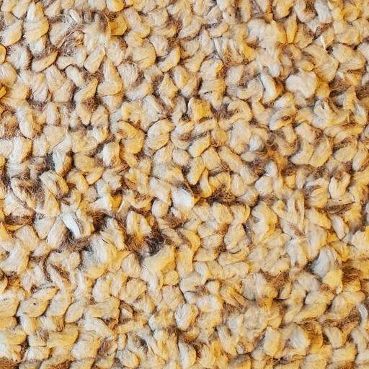
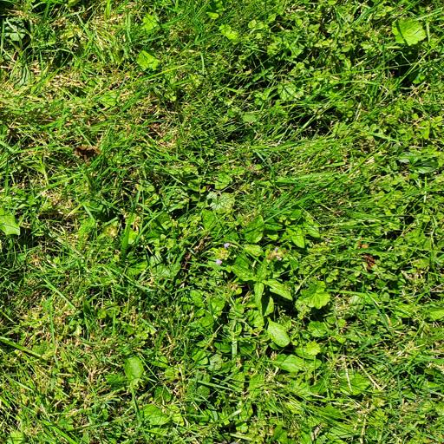
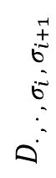
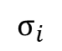
$$D_{⋅ , ⋅ ,{ σ}_{i} ,{ σ}_{i+1}}$$
$$σ_{i}$$

Slide 4
$$D_{⋅ , ⋅ ,{ σ}_{i} ,{ σ}_{i+1}}$$
$$σ_{i}$$

Slide 5
$$d_{max}$$
$$D_{240, 120,{ σ}_{ι} ,{ σ}_{ι+1}}$$
$$d_{max}$$
$$D_{310, 200,{ σ}_{ι} ,{ σ}_{ι+1}}$$
$$D_{⋅ , ⋅ ,{ σ}_{i} ,{ σ}_{i+1}}$$
$$d_{max}$$
$$d_{max}$$
$$D_{445, 255,{ σ}_{ι} ,{ σ}_{ι+1}}$$
$$D_{260, 70,{ σ}_{ι} ,{ σ}_{ι+1}}$$
$$σ_{i}$$
Notes:
tg

Slide 6
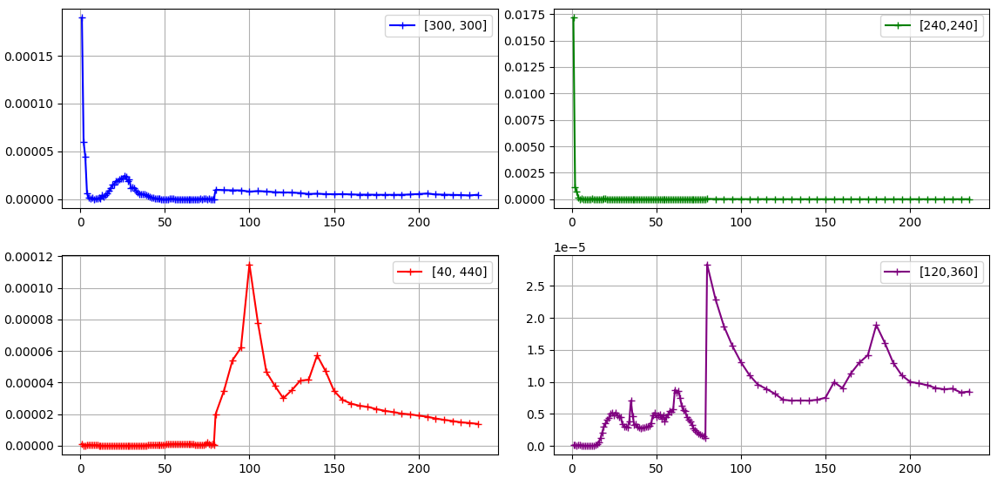
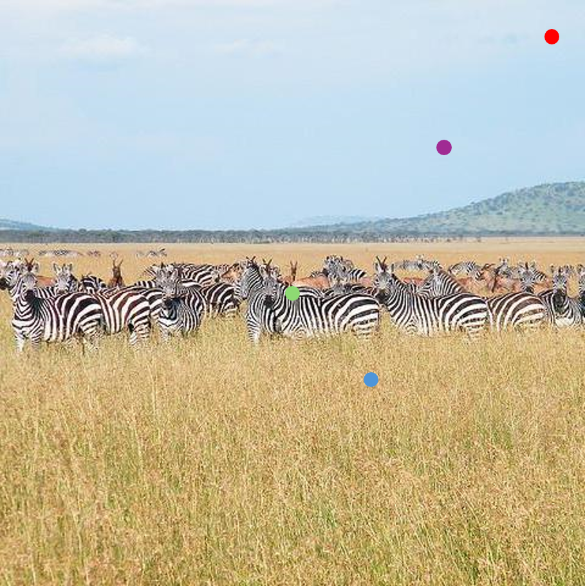

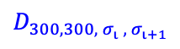
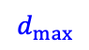
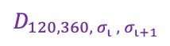
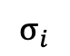
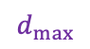
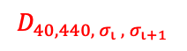
$$d_{max}$$
$$d_{max}$$
$$D_{300, 300,{ σ}_{ι} ,{ σ}_{ι+1}}$$
$$D_{⋅ , ⋅ ,{ σ}_{i} ,{ σ}_{i+1}}$$
$$d_{max}$$
$$D_{120, 360,{ σ}_{ι} ,{ σ}_{ι+1}}$$
$$d_{max}$$
$$D_{40, 440,{ σ}_{ι} ,{ σ}_{ι+1}}$$
$$σ_{i}$$
Notes:
tg

Slide 7
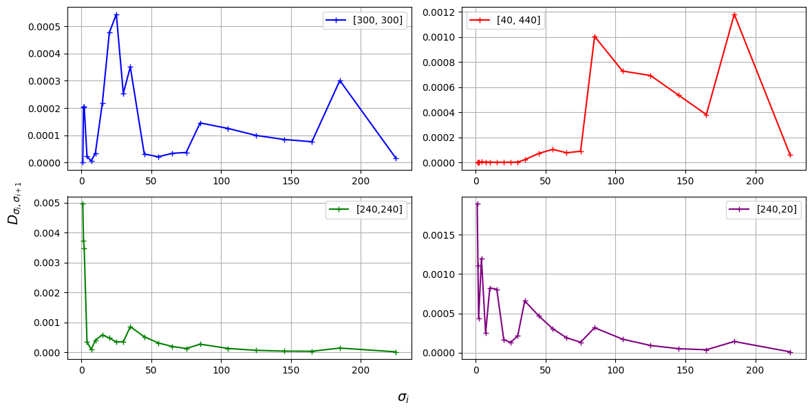
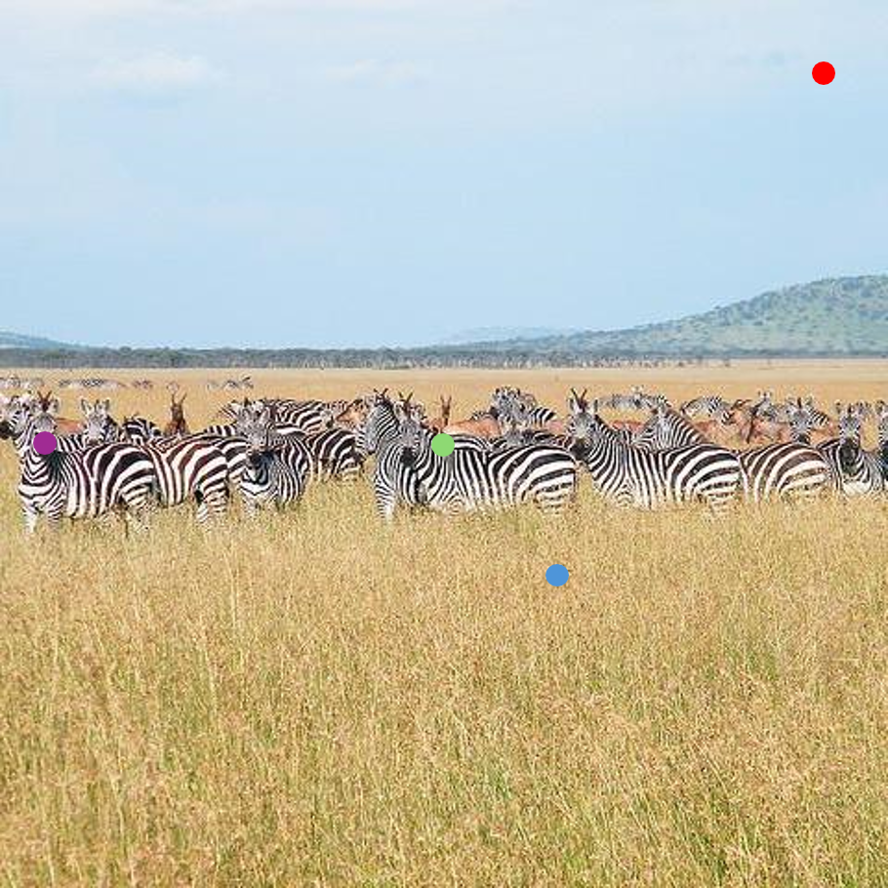
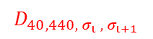
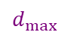
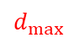
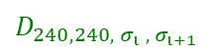
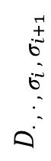
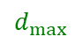
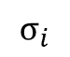
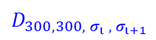
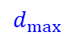
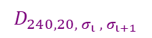
$$d_{max}$$
$$d_{max}$$
$$D_{40, 440,{ σ}_{ι} ,{ σ}_{ι+1}}$$
$$D_{300, 300,{ σ}_{ι} ,{ σ}_{ι+1}}$$
$$D_{⋅ , ⋅ ,{ σ}_{i} ,{ σ}_{i+1}}$$
$$d_{max}$$
$$d_{max}$$
$$D_{240, 20,{ σ}_{ι} ,{ σ}_{ι+1}}$$
$$D_{240, 240,{ σ}_{ι} ,{ σ}_{ι+1}}$$
$$σ_{i}$$
Notes:
tg

Slide 8
Notes:
tg

Slide 9
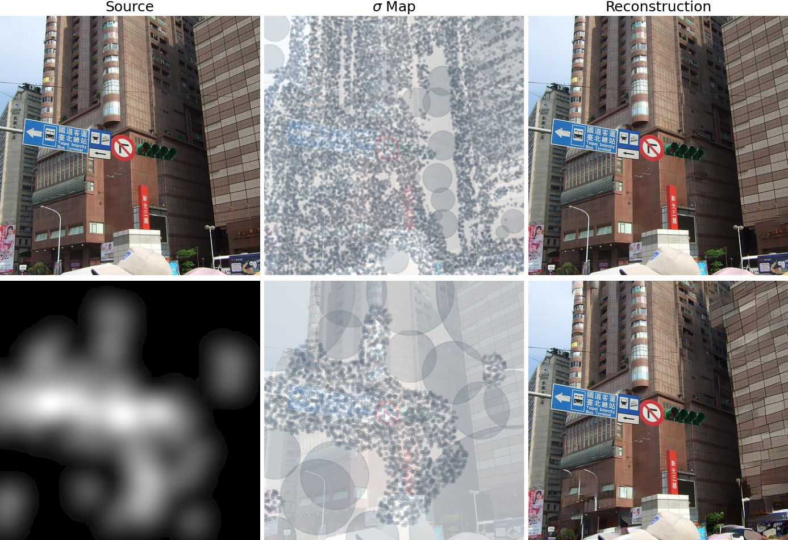

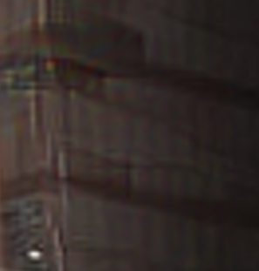
Notes:
tg

Slide 10
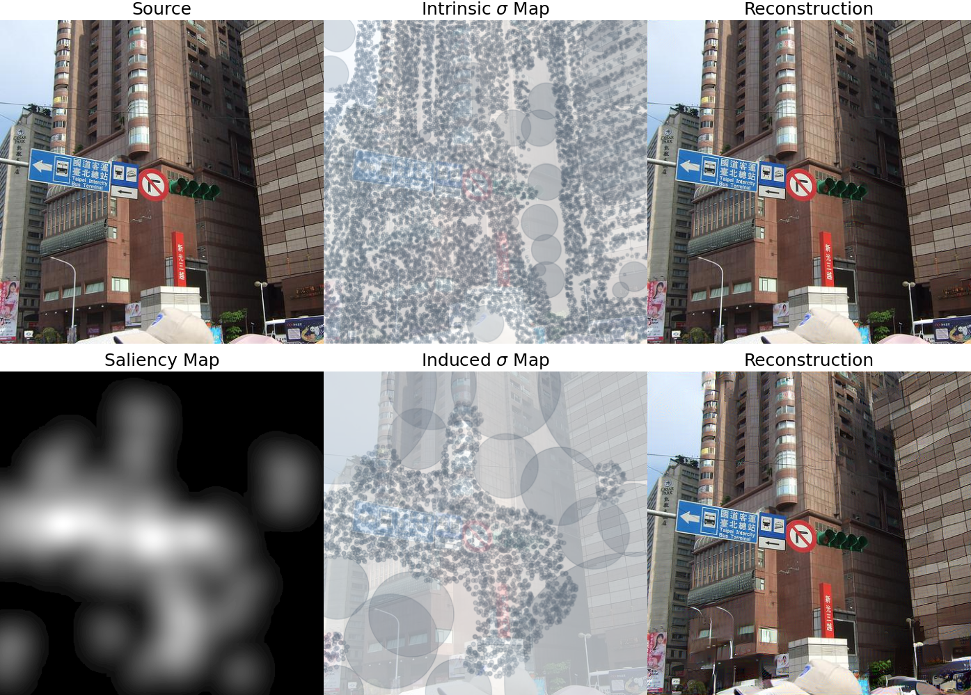
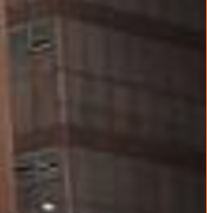
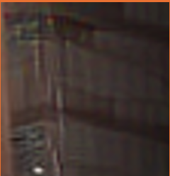

Slide 11
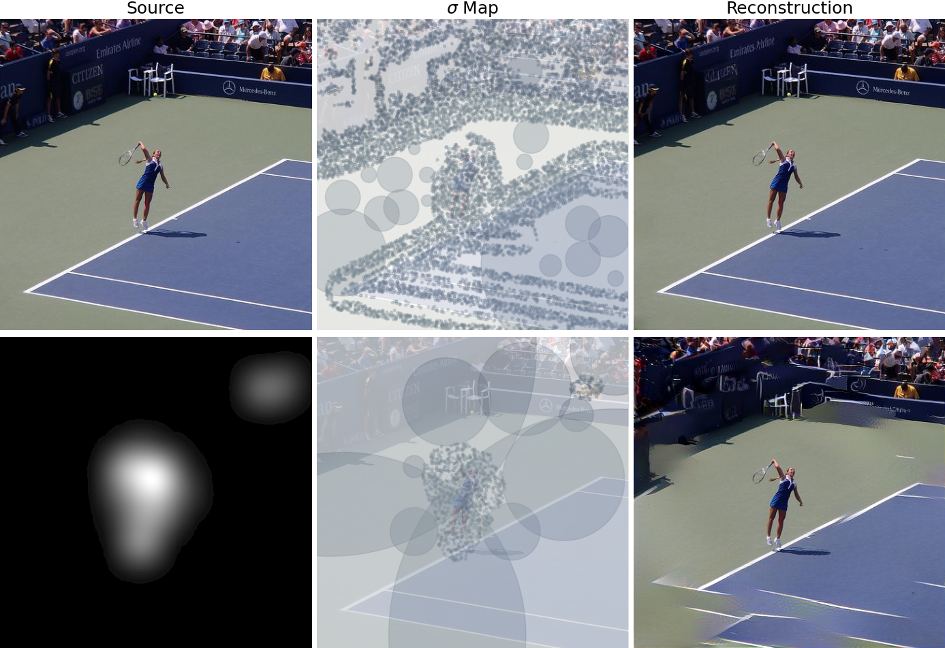

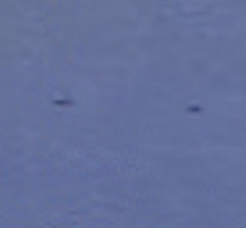

Slide 12
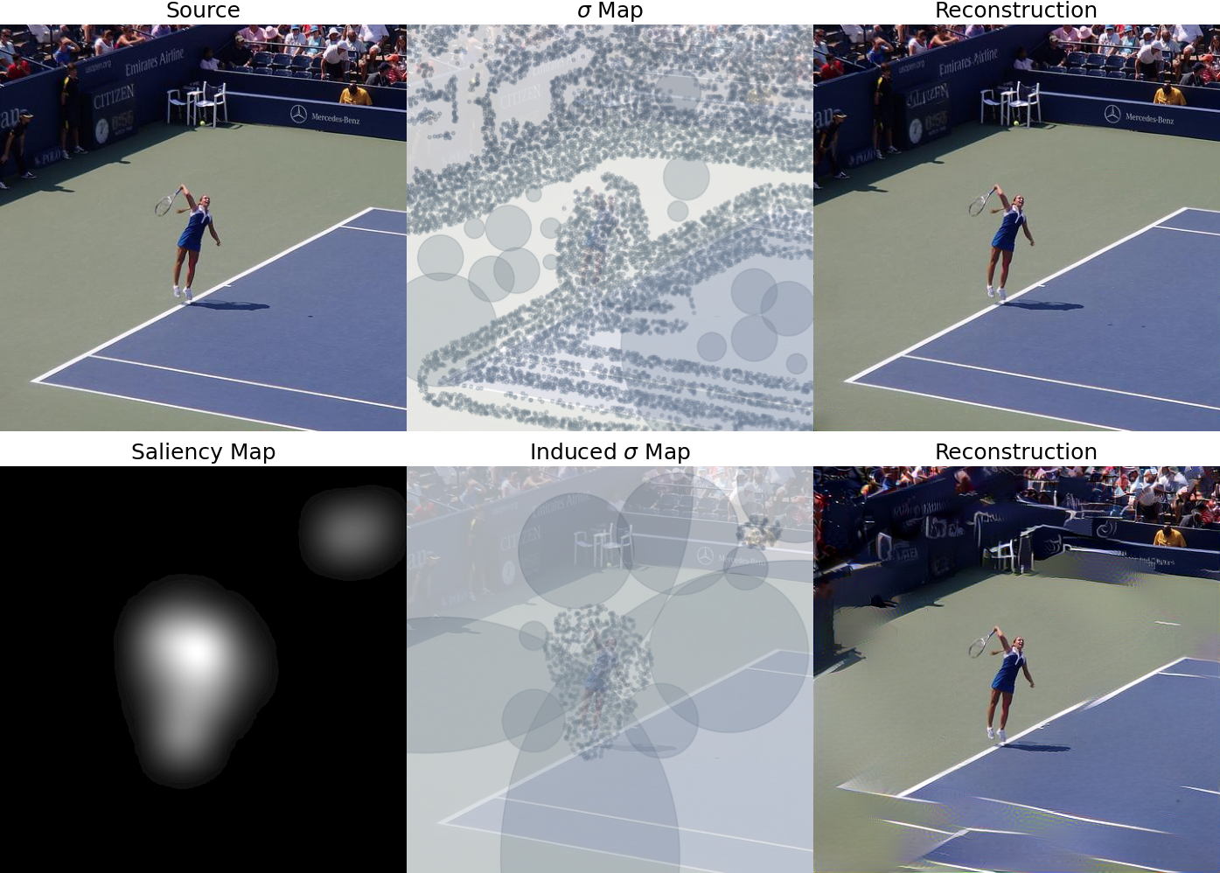



Slide 13




Slide 14


Slide 15






Slide 16










Slide 17








Slide 18




Slide 19




Slide 20




Slide 21




Slide 22

How to convert σ-map to Saliency Map
Data Processing:
Local Neighborhood Analysis: For each pixel in the image, a circular neighborhood around it is analyzed.
Zero Value Proportion Calculation: Within this neighborhood, the proportion of zero values is calculated to capture the local texture characteristics.
Thresholding: Apply a threshold to the saliency map, setting all values below the threshold to zero, highlighting only the most significant regions

Slide 23




Slide 24




Slide 25




